Slide 1
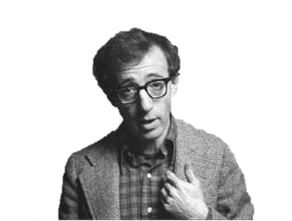
Deconstructing Woody
Aleksandra Bliznyuchenko
Maria Levchenko

Slide 2
Tools
Stylo
Mallet
Python
WikiData
Process
Write a python code and extract screenplays and reviews
Get topics of every screenplay, then overall topics
Run scripts in stylo
Arrange in Google Spreadsheets
Source
springfieldspringfield.co.uk
rottentomatoes.com
Goal
Understand, why his films are so low-rated now compared to previous triumphs

Slide 3
Topics
"God, work and love" good make love time great back life god thing thought work hey give call told book man put lot
"Writing & Some Action" wait rain mind writing pretty care telling love bank carol finally fella napoleon played marry script kind london beautiful
"Lifestyle" feel chinese day matter story picture open card white doctor ago good hell dough prison dub restaurant fantastic paper
"Friends" opera place part face future friends mine guitar anymore willie idea foundation figure honour wheat killer
"Affair in marriage" darling understand lunch wine doctor man melody famous past affair house played mmm park making yeager milos blind mom boyfriend

Slide 4
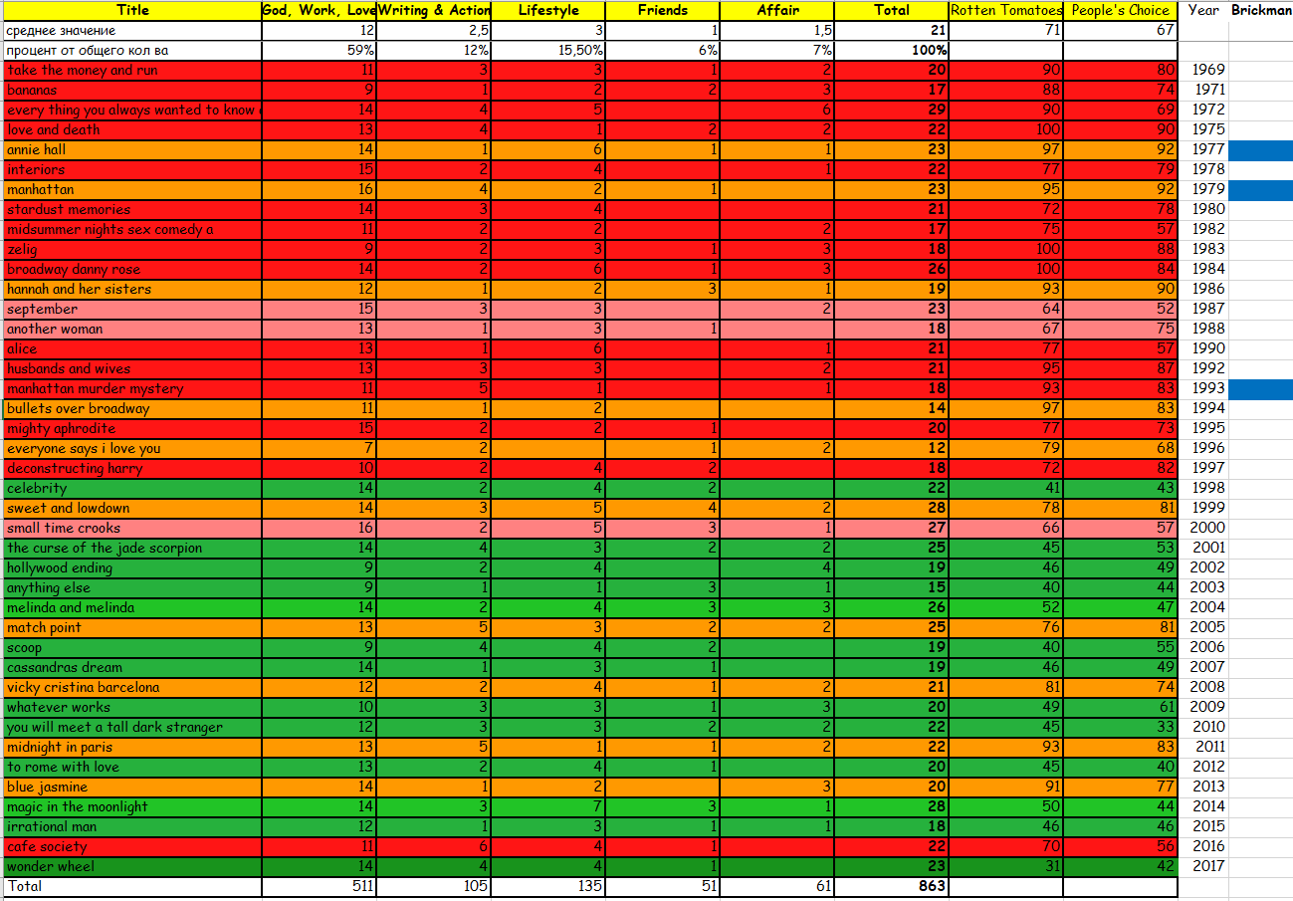
Sorted by year

Slide 5
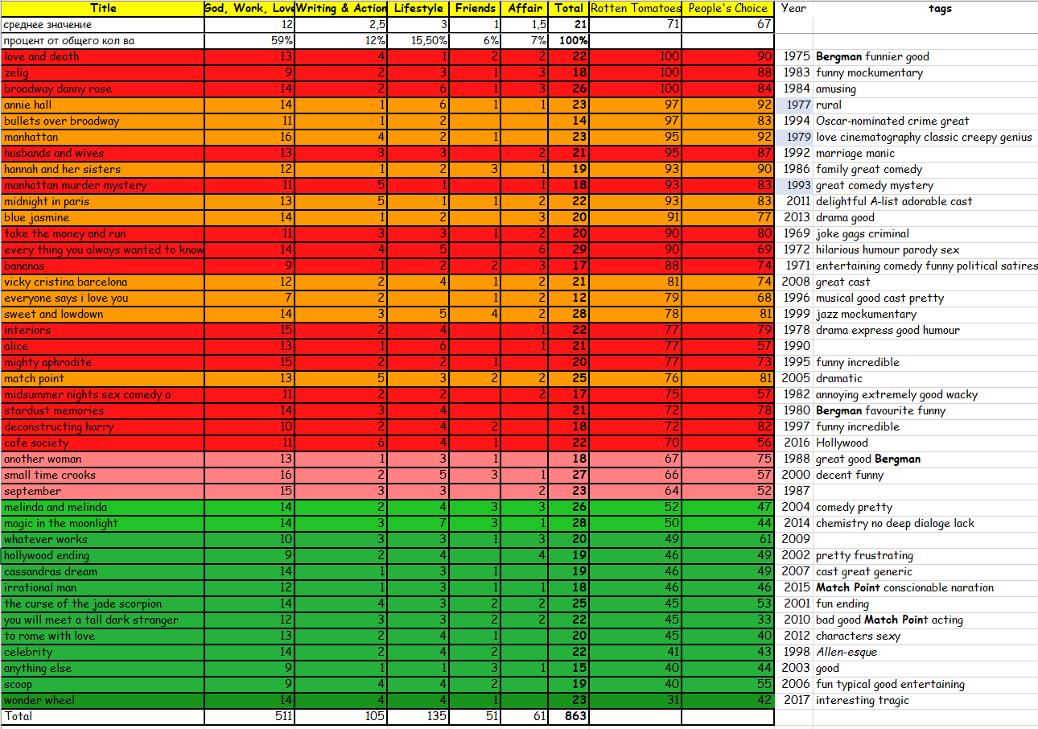

Sorted by tomatometer

Slide 6
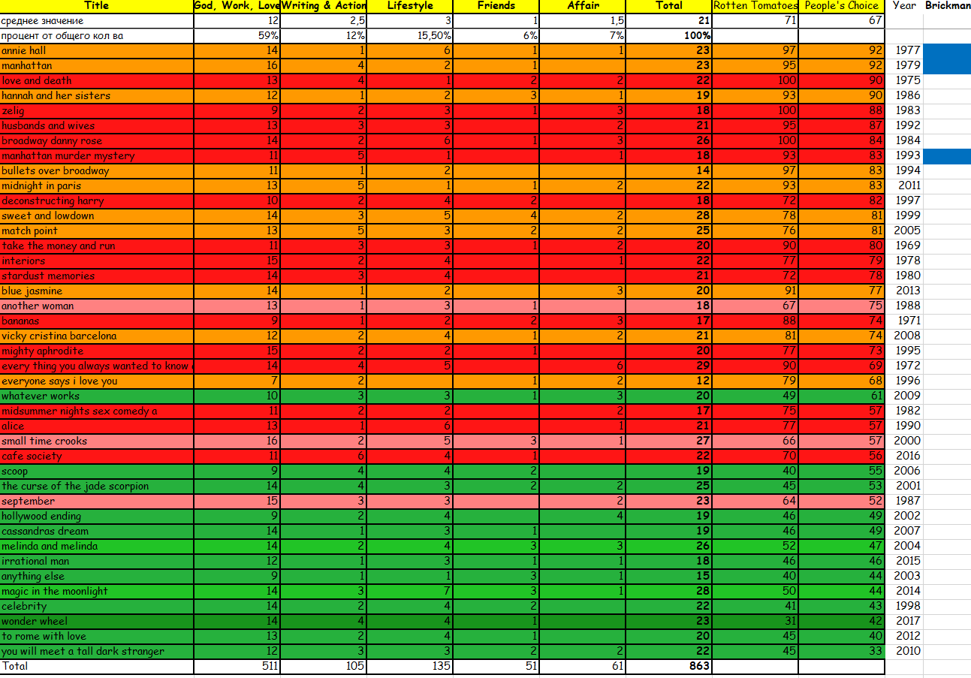
Sorted by People’s choice

Slide 7
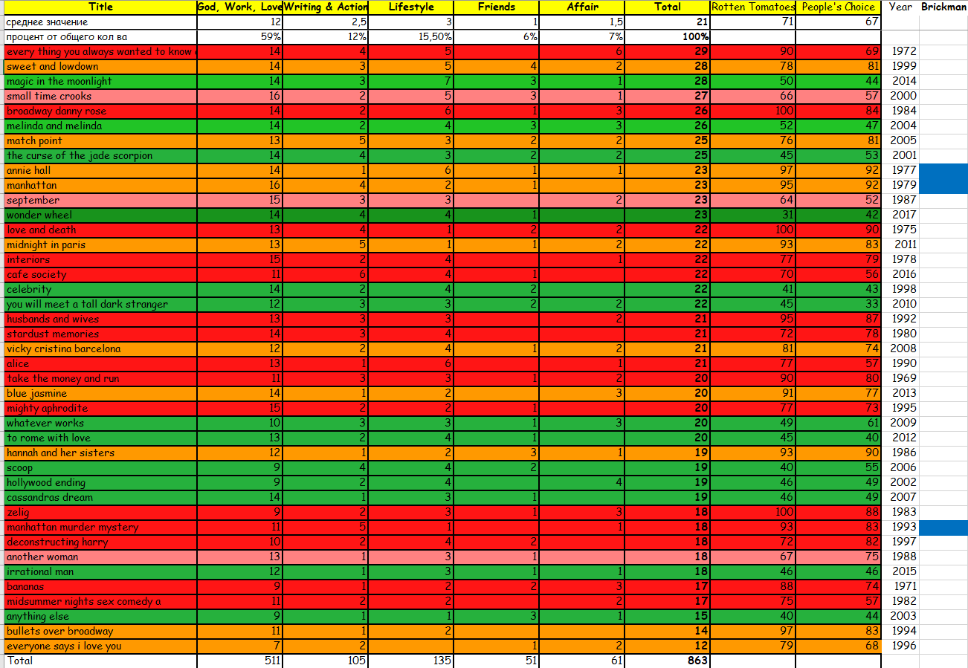
Sorted by % of topics

Slide 8
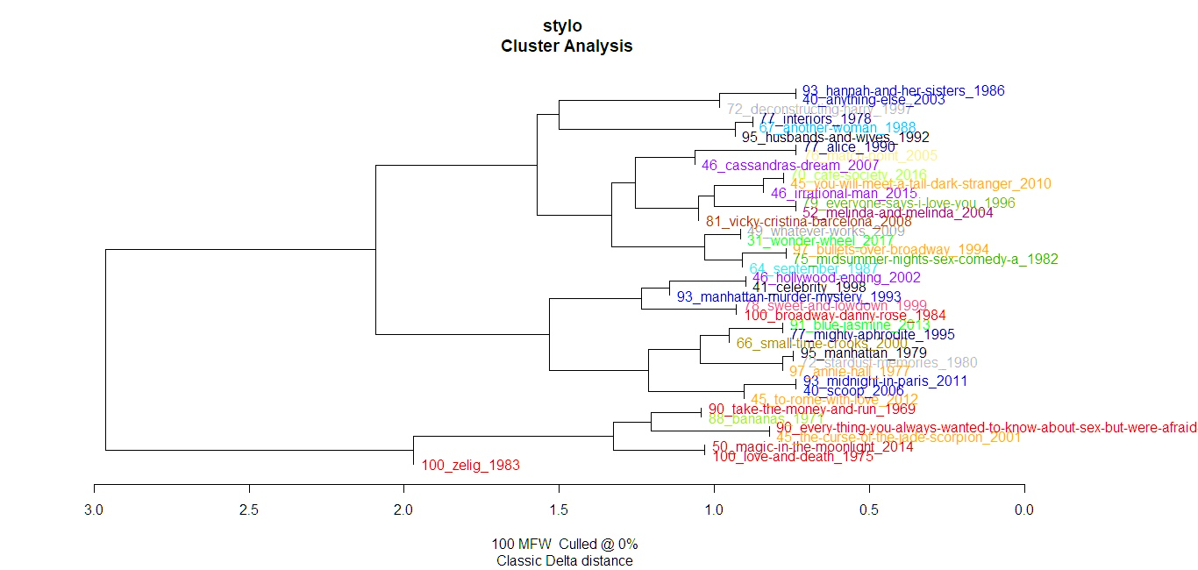

Slide 9
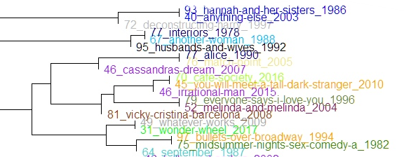
Self-repeating

Slide 10
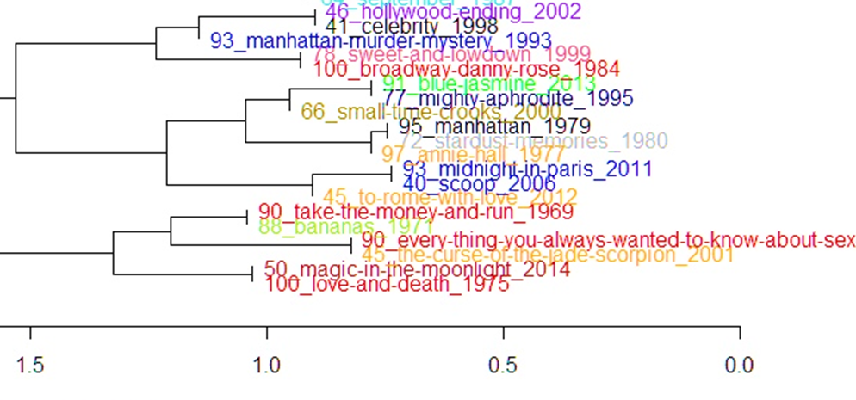
Brickman

Slide 11
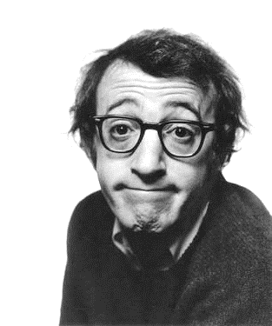
Conclusions
Self-repeating is a dangerous strategy
People love him for his humour
Tomatoes vs People – people love less
Bergman? Match point?

